Slide 1
Regional Speech Recognition Using Federated Learning
Project Stream: Natural Language Processing
Guide : Dr. J Geetha Reddy
Team Members Name: K J Sundeep Kumar
Hariharan R
Mahesh
Darshan H S
Institute Name: Ramaiah Institute of Technology

Slide 2
Objectives
Speech recognition systems that works on Indian regional languages.
Training and Recognition of regional variants.
An interface which enables a user to speak out and convert into desired text output(speech to text).

Slide 3
Federated Learning
Federated learning (also known as collaborative learning) is a machine learning technique that trains an algorithm across multiple decentralized edge devices or servers holding local data samples, without exchanging them. This approach stands in contrast to traditional centralized machine learning techniques where all the local datasets are uploaded to one server

Slide 4
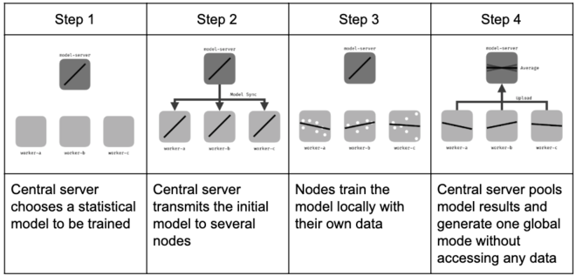
Train global model in the server.
Deploy global model to devices.
Optimize model from each device.
Upload local trained model update.
Average local trained model update.
Deploy Averaged global model to devices
Repeat step 2 to step 6

Slide 5
Approach
A Speech Recognition system that enhances its functionality by learning based out of federated learning.
We are using federated learning to optimize and recognise the differences within the language spoken at different places thereby collecting these data points which help in future recognising these variations.
This solution will increase accuracy of the recognition.

Slide 6
Benefits
Better translators can be designed keeping this system as a base.
Incremental learning (due to federated learning) leading to Higher accuracy and broader recognition.

Slide 7
Thank You

